Slide 1

“YO, YOU CAN’T PARK HERE!”: NYC PARKING VIOLATIONS
AN ANALYSIS OF PARKING VIOLATIONS USING DATA WAREHOUSING
Group 9:
Jordan bender, ya ting chang, arpit Chaudhary, chi zhang, jianfu zhang
Prof. Bob Brichacek

Slide 2
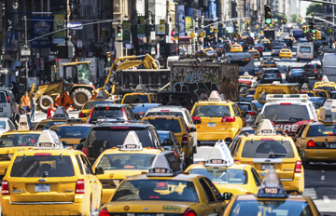
BUSINESS OVERVIEW: ROOM FOR IMPROVEMENT
NYC OpenData publishes yearly parking violation information
With this data, it is possible to analyze macro-trends across the Five Boroughs and micro-trends on city blocks
We believe this data can be used to decrease parking violations by providing more information to Ticket Issuers, while increasing traffic flow.
Photo Source:
http://www.bostoncoachblog.com/wp-content/uploads/2014/09/NYC-traffic.jpg

Slide 3
BUSINESS OVERVIEW: QUESTIONS WE CAN ANSWER
Some examples of questions we can answer:
What time slots are tickets most likely to be issued in Brooklyn on Friday nights?
What borough suffers the most parking violations on weekends?
Which season are people more likely to park unlawfully?
What color of cars generated the most fines in Q3?
Are there any places in the city that are in need of better parking signage?

Slide 4
DIMENSIONAL MODELING STEPS
1. Business Question:
How can we maximize our understanding of parking tickets to decrease violations and increase compliance?
2. Grain:
Our Grain is summons key, violation key, date key, time key, issuer key, and car key.
3. Dimensions:
Our Dimensions are Location, Car, Issuer, Date, and Time. We have a Summons Key that is a Degenerative Dimension.
4. Facts:
Our Facts are Violation Code and Ticket Price, Plate ID, and House Number.

Slide 5
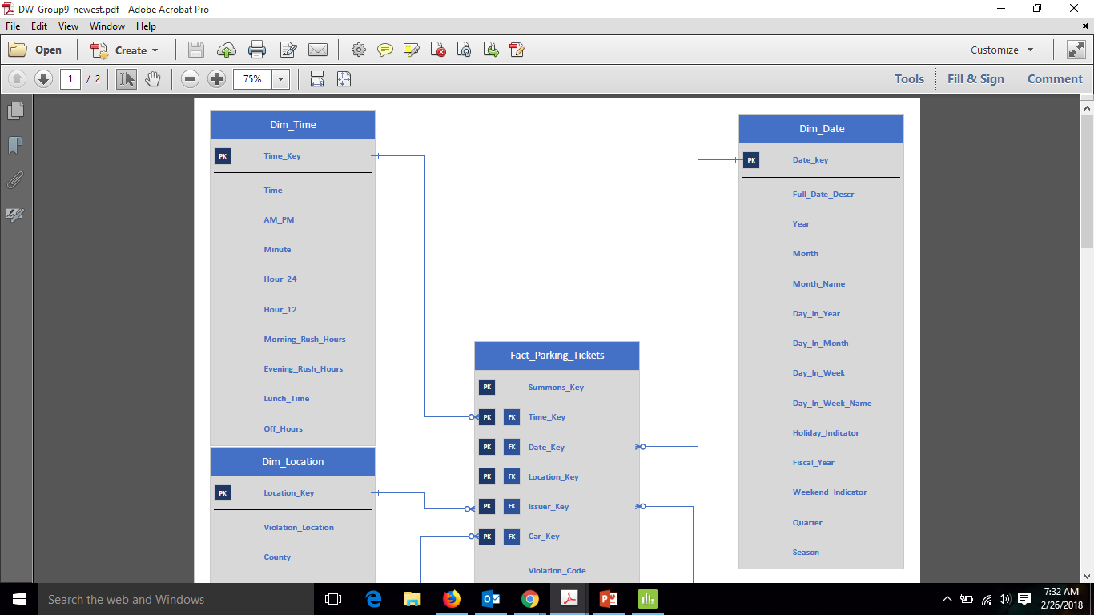

Slide 6
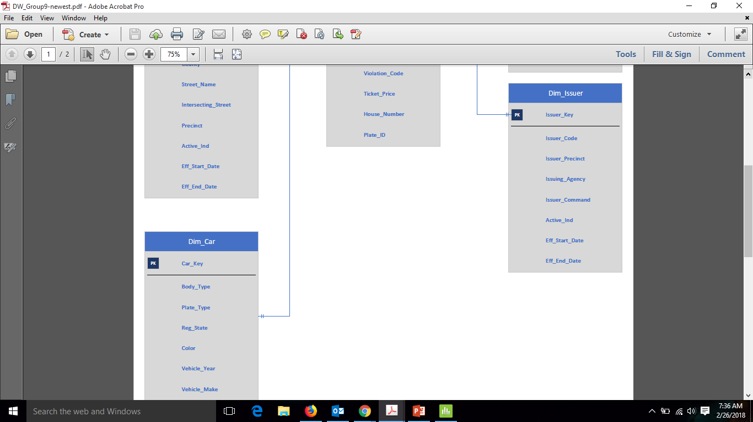

Slide 7
DIMENSIONAL MODEL: DIMENSIONS, KEY ATTRIBUTES, AND HIERACHIES
Location: Allows an understanding of where the violation occurred. Key Attributes: County, Street Name, and Precinct. Hierarchies – Prioritizing Street and County (Borough) over Intersection.
Car: Allows an understanding of the type of car to better understand the distribution of violations. Body Type, Color, Make, and Registration State. Hierarchies – Depends! But no inherent hierarchies.
Issuer: Allows an understanding of the Issuer and their command. Issuer Code, Precinct, and Command. Hierarchies – No inherent hierarchies.
Date: Allows an understanding of weekly, monthly, yearly, or seasonal distribution of violations. Key Attributes: Day and Week, Quarter, and Seasons. Hierarchies - Year, Season/Quarter, Month, Week, and Day.
Time : Allows an understanding of time of day and special indicators, for example: Rush Hours. Key Attributes: Hours and Special Indicators. Hierarchies - Hour and Minute.

Slide 8
DIMENSIONAL MODEL: SCD TYPE 2 FIELDS
Issuer:
Issuing Precinct (This is our demonstrated SCD Type 2.)
Issuer Command
Issuer Agency
Location:
Precinct (This is our demonstrated SCD Type 2.)
County
Violation Location

Slide 9
DIMENSIONAL MODEL: FACTS AND MEASURES
Violation Code – Specifies the violation that occurred.
This non-additive attribute allows us to understand which violation occurred and to link it to a ticket price.
Ticket Price – Specifies the amount due per ticket issued.
This additive attribute allows us to total tickets across violations as a whole or across numerous other measures, such as fines charged across neighborhoods.
Plate ID – Specifies the plate tied to the car for a summons.
This non-additive attribute allows us to identify a unique car per summons and learn more about the specific transaction and car type.
House Number - Specifies the location of the violation on a street.
This non-additive attribute allows us to pinpoint a location on a potentially long NYC street by isolating to the house/building level on that street.

Slide 10
DIMENSIONAL MODEL: TOTAL NUMBER OF RECORDS
Original Records:
4.2 Million Rows to start (via NYC OpenData)
Fact Table:
95,807 Rows
Dimension Tables:
Location: 25,822 Rows
Car: 16,508 Rows
Issuer: 17, 335 Rows
Date: 365 Rows
Time: 1,440 Rows

Slide 11
ETL OVERVIEW: INPUT DATA SOURCES
NYC OpenData (.csv)
Full information about each summon that we broke into dimensions. This is the bulk of our data that underwent ETL.
Violation Ticket Amount (.csv)
Information connecting the Violation Code to a specific Ticket Price. This was standardized and cleaned to be uploaded into the warehouse.
Date/Time Excel Sheet (.csv)
Manually-generated and edited Date and Time Excel sheets that were later added as Dimensions to our warehouse.

Slide 12
ETL OVERVIEW: HOW WE LOADED THE DATA
Tools:
Transformed data with R and Python; Loaded data with SSIS
Before our data was ready to use, we had to clean data. Examples include:
Added Ticket Price using external data
By mapping Ticket and Violation Time
Changed County to readable format,
Standardized Car Color
Fixed years later than 2017 that were errors (ex. “2064”)
Standardized the times on tickets to standard times (ex. Eliminating “26:00”)
Matched County to Violation Locations
Consolidations: Our raw data was divided appropriately, so no consolidations were needed. Thanks NYC OpenData!

Slide 13
ETL OVERVIEW: SCD TYPE 2 IMPLEMENTATION
Issuer Dimension:
Attributes: Issuing Precinct, Issuer Command, Issuer Agency
Reason: Over time, people move Precincts, transfer Agencies, or Command changes.
This was completed with the Slowly Changing Dimension Wizard in SSIS.
Location Dimension:
Attributes: Precinct, County, Violation Location
Reason: Location codes or names can change. More often, the Precinct changes as populations and zoning changes in neighborhoods.
This was completed with the Slowly Changing Dimension Wizard in SSIS.

Slide 14
ETL OVERVIEW: LESSONS LEARNED
Data entry at the beginning of a project is very important. Our project can vastly simplified if initial data collection is done consistently and cleanly. Ex: Ticket Issuers keying incorrect dates or locations.
The Transformation process would be much smoother with cleaner data, so it is better to check and double check data before attempting to load into the warehouse. Otherwise, you risk re-doing data loading as you notice problems, re-clean data, and re-load.
The ETL Process takes longer than you think it will. Plan ahead!

Slide 15
BUSINESS REPORTS
SELECT County AS "Borough", COUNT(Summons_Key) AS "Number Of Tickets Issued",
RANK() OVER (ORDER BY COUNT(Summons_Key) DESC) AS "Rank"
FROM
[dbo].[Fact_Parking_Tickets]
JOIN [dbo].[Dim_Location] on [dbo].[Dim_Location].[Location_Key] = [dbo].[Fact_Parking_Tickets].[Location_Key]
JOIN [dbo].[Dim_Date] ON [dbo].[Dim_Date].Date_Key = [dbo].[Fact_Parking_Tickets].Date_Key
WHERE Weekend_Indicator = 1
GROUP BY County
ORDER BY "Rank"
County | Total Amount of Fine Issued | Rank
BROOKLYN | $2,203,149.00 | 1
QUEENS | $1,481,280.00 | 2
MANHATTAN | $846,146.00 | 3
BRONX | $811,574.00 | 4
STATEN ISLAND | $135,530.00 | 5
OTHER | $112,780.00 | 6

Slide 16
BUSINESS REPORTS (Cont.)
SELECT *
FROM
(SELECT House_Number "House Number", Street_Name AS "Street Name",
COUNT(Summons_Key) AS "Number Of Tickets Issued",
RANK() OVER (ORDER BY COUNT(Summons_Key) DESC) AS "Rank"
FROM
[dbo].[Fact_Parking_Tickets]
JOIN [dbo].[Dim_Location] on
[dbo].[Dim_Location].[Location_Key] = [dbo].[Fact_Parking_Tickets].[Location_Key]
WHERE House_Number not like ''
GROUP BY House_Number, Street_Name) AS House_Street
WHERE "Rank" <= 10
ORDER BY "Rank"

Slide 17
BUSINESS REPORTS (Cont.)
House Number | Street Name | Number Of Tickets Issued | Rank
1 | ORCHARD BEACH RD | 107 | 1
80-26 | BAXTER AVE | 94 | 2
3 | SOUNDVIEW AVE | 82 | 3
2875 | W 8 ST | 82 | 4
1904 | SURF AVE | 75 | 5
15 | OCEAN AVE | 72 | 6
175 | ADAMS ST | 62 | 7
25-40 | SHORE BLVD | 61 | 8
884 | 67 ST | 56 | 9
901 | 12 AVE | 49 | 10

Slide 18
BUSINESS REPORTS: SQL FUNCTIONS AND KNOWLEDGE GAINED
Some of the general and analytic SQL functions used:
Rank
Count
Sum
Group by; Order by
Formatting for Currency and Date/Time Display
Business Knowledge Gained (some examples):
Total Amount Fined by Borough (Brooklyn charged most)
Tickets by Season (Very seasonal with Summer most/Fall close second)
Time of Day with Most Tickets (5:00 p.m. – 5:59 p.m. has the most tickets)

Slide 19
BUSINESS REPORTS: ADDITIONAL REPORTING DIRECTION
Additional Ideas for Reports to Run (a sampling of the possibilities):
Ranking Streets by overall cost or specific violations over the whole city; by Borough; by Neighborhood
Ranking Car attributes more – such as which Make, Model, or Years have the most violation; may not be overly useful for enforcement, but could be used for understanding preferences or wealth distribution across the city.
Ranking by Registration State – which states (other than NY and NJ) receive the most violations

Slide 20
BUSINESS REPORTS: ADDITIONAL DATA SOURCES DESIRED
In order to run more reports and perform other business analysis, we’d love to have:
Cleaner data with a more strict data entry procedure
Demographic Data
Data on Residential Neighborhoods (Characteristics of neighborhood and how it affects parking)
Data on Businesses, Parks, and Other Amenities around the violations
Weather Information
Traffic Flow Information

Slide 21
LESSONS LEARNED
What We’ll Do Differently for Our Next Warehouse:
Have a stricter procedure for data entry that improves data quality (if we have control over this step)
Clean the data thoroughly before attempting to load into our warehouse (this will save us time and frustration in the long run)
Data Integrity is paramount throughout – be sure our data is mapping the correct way and we understand the connection between the attributes
Consider the size of our Dimension Tables when designing the dimensions (estimate rows before we upload so that we know we have the right layout and granularity)
Double check that we have all our Natural Keys correct, especially for any SCD Type 2 attributes

Slide 22

Q & A
Photo Source:
https://www.flickr.com/photos/psd/2086641

